Slide 1
Opioid-, amphetamine-, and cocaine-induced deaths in Australia: August 2018

Slide 2
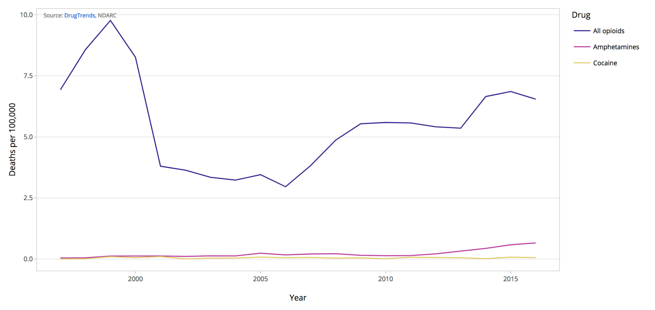
Opioid-, amphetamine- and cocaine-induced deaths

Slide 3
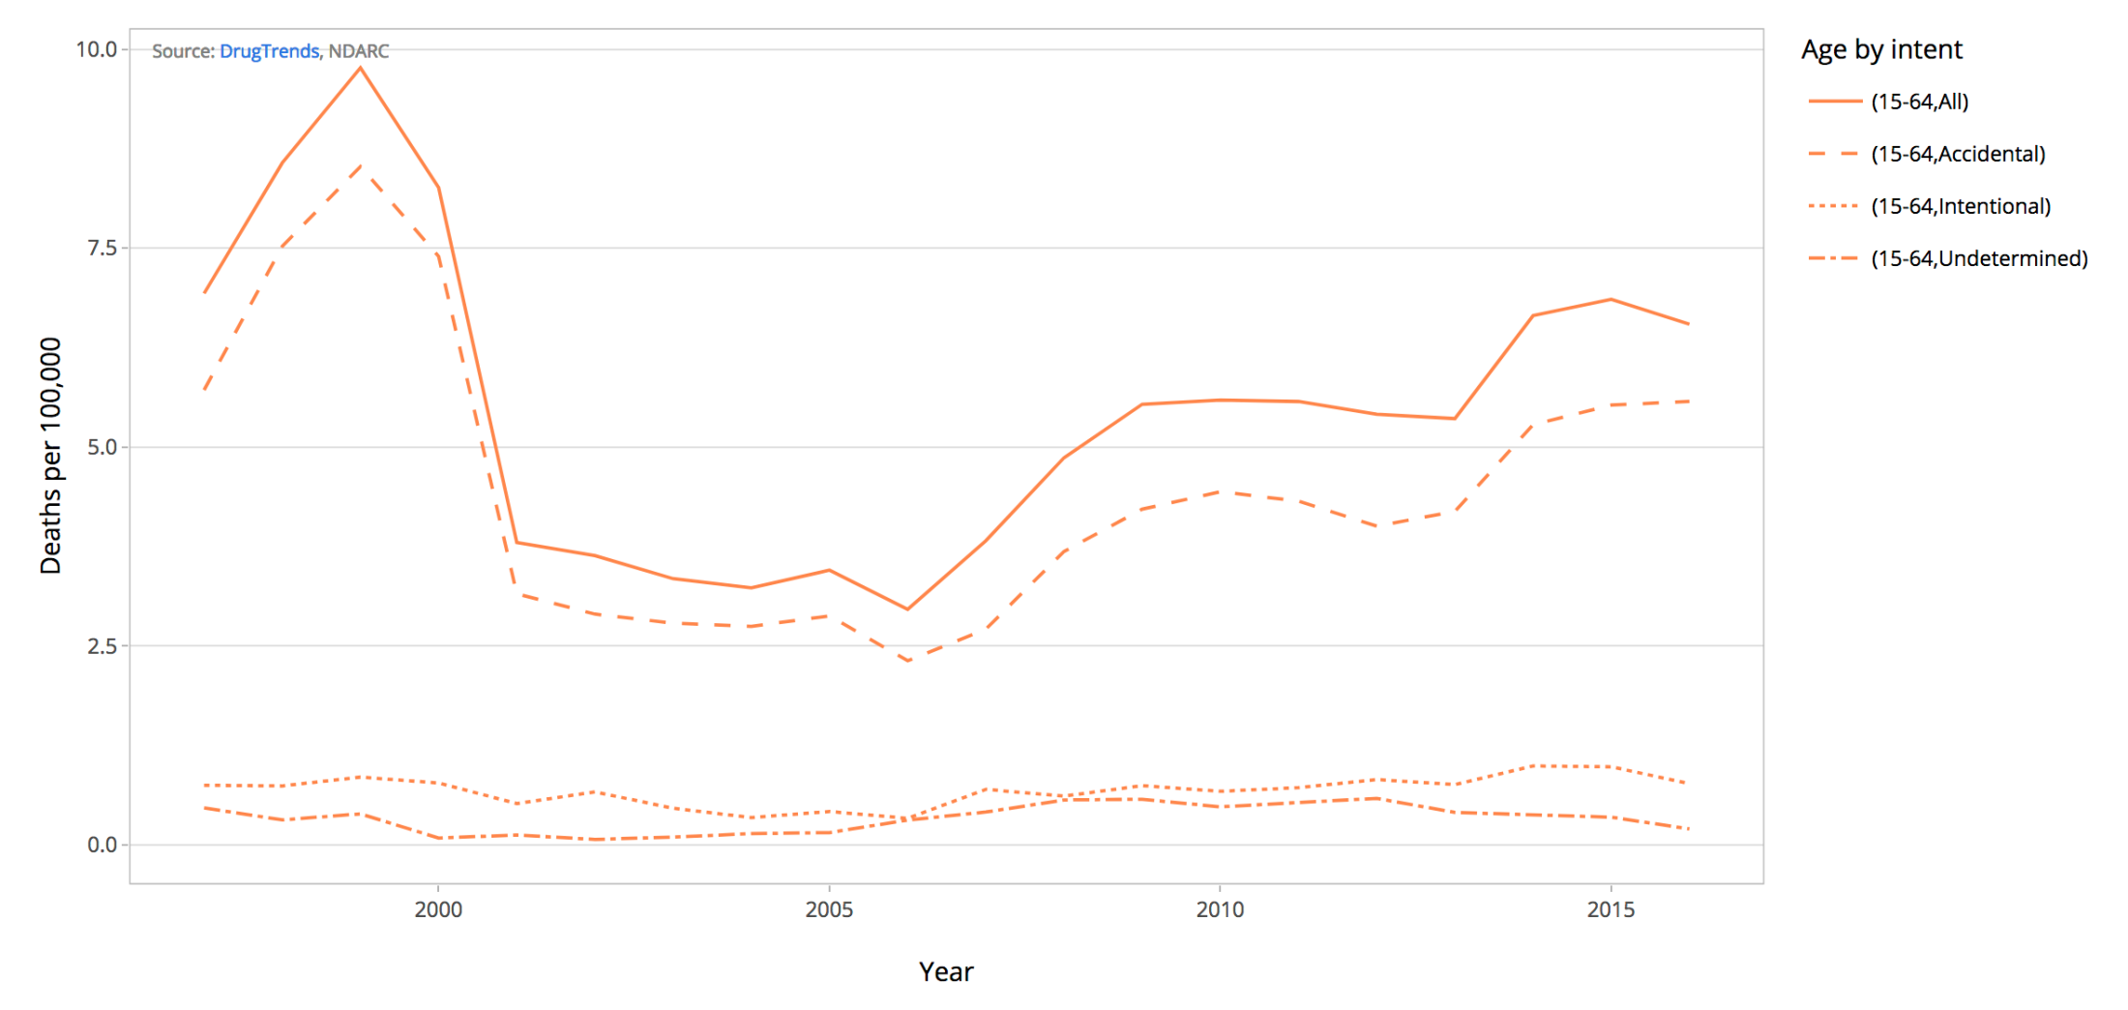
Opioid-induced deaths by intent

Slide 4
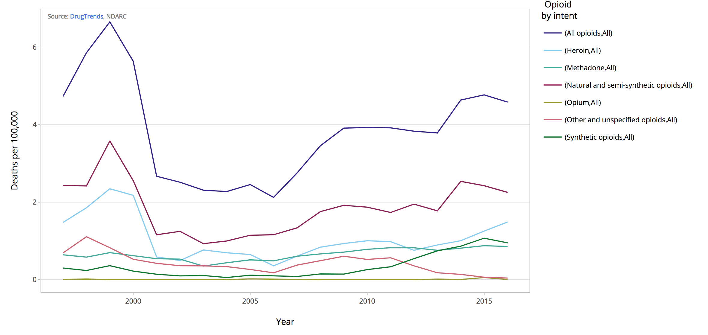
Opioid-induced deaths by opioid
Natural and semi-synthetic opioids include morphine, codeine and oxycodone
Synthetic opioids include fentanyl, tramadol and pethidine

Slide 5
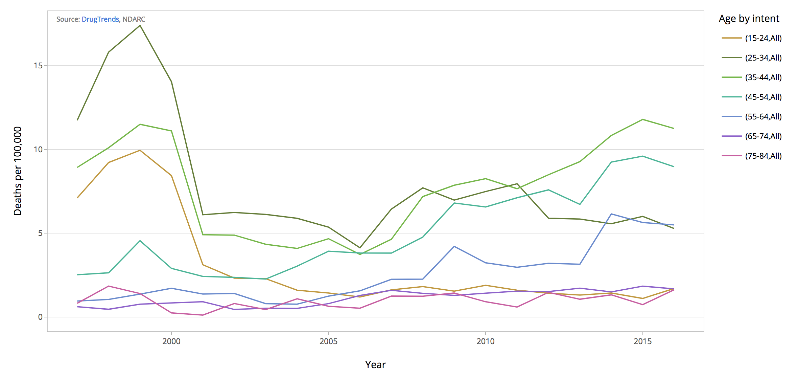
Opioid-induced deaths by 10 year age group

Slide 6
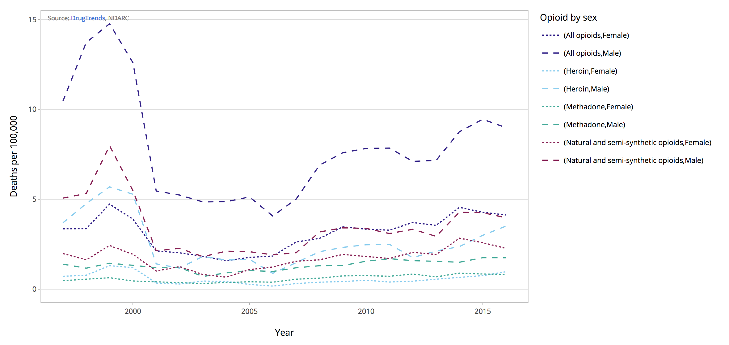
Opioid-induced deaths by opioid and sex
Natural and semi-synthetic opioids include morphine, codeine and oxycodone

Slide 7
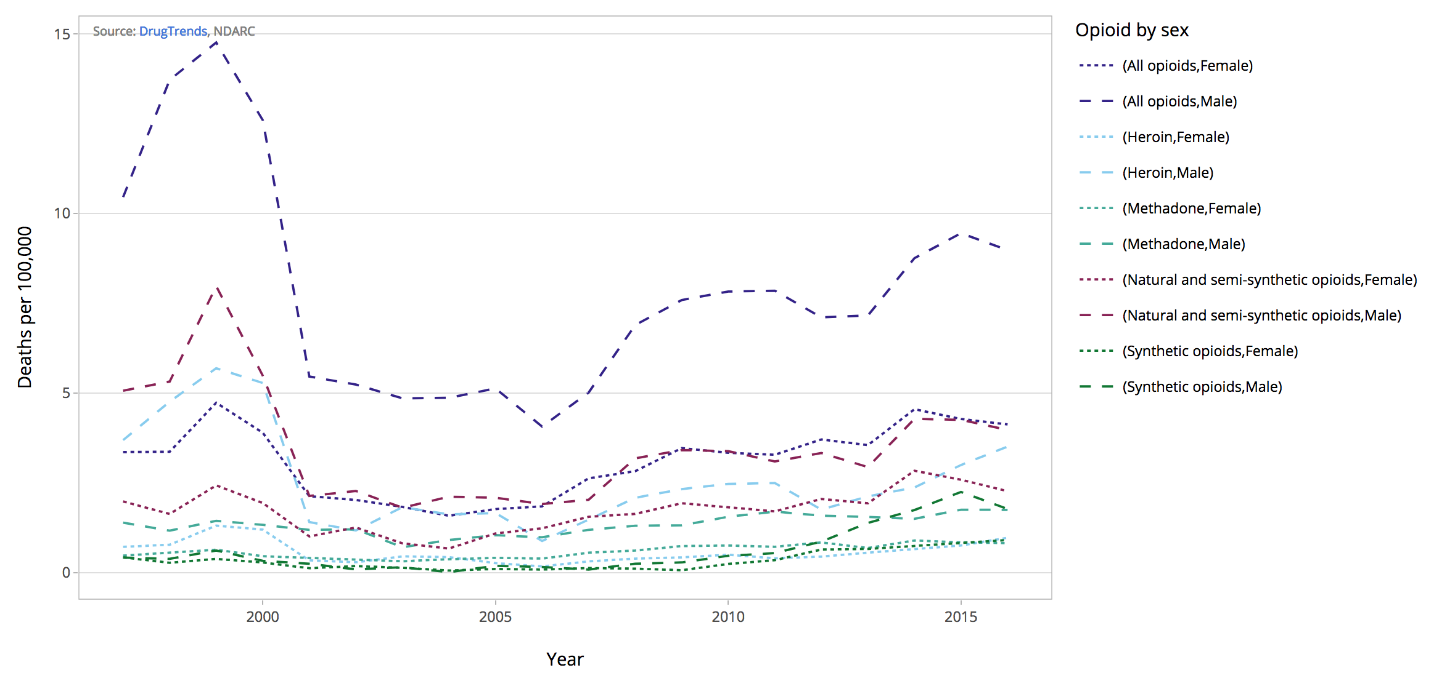
Opioid-induced deaths by opioid and sex
Natural and semi-synthetic opioids include morphine, codeine and oxycodone
Synthetic opioids include fentanyl, tramadol and pethidine

Slide 8
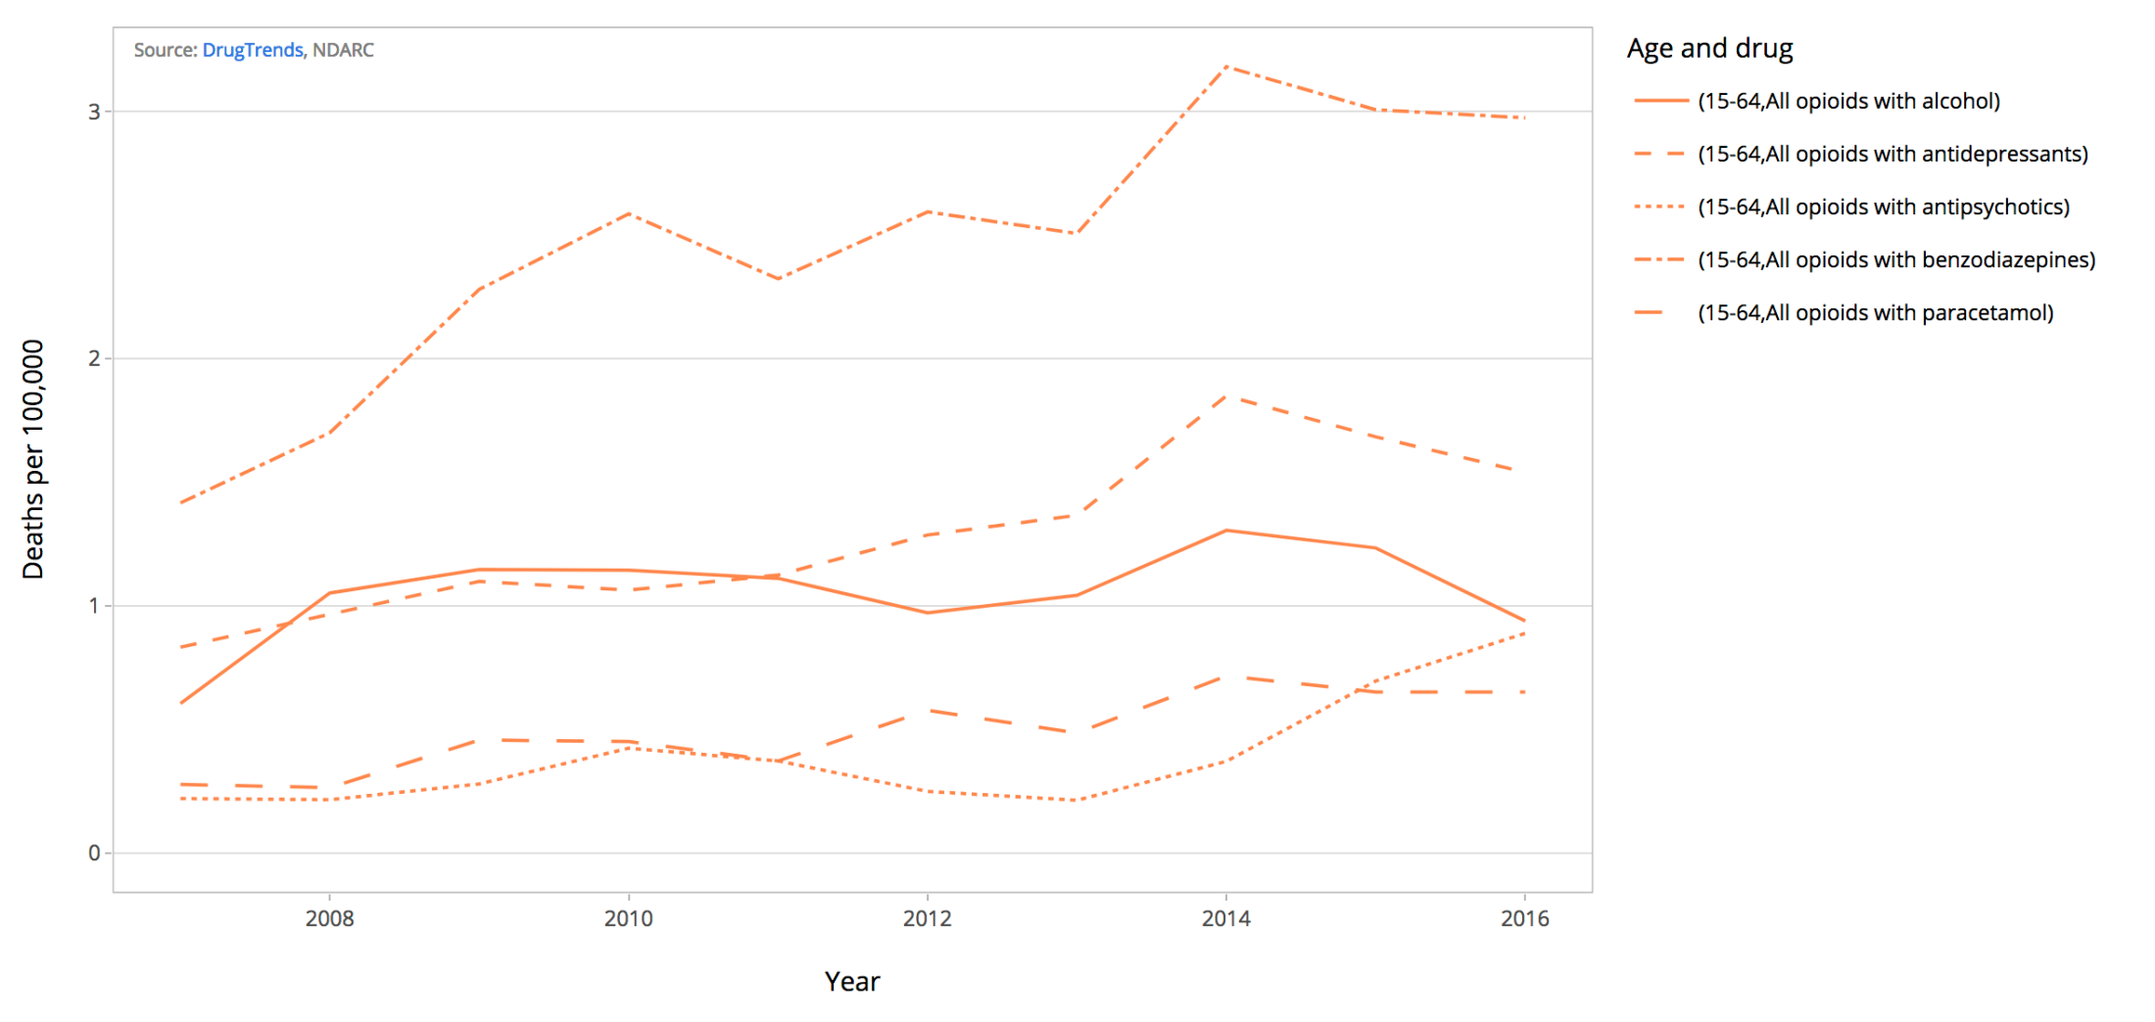
Opioid-induced deaths with other drugs contributing

Slide 9
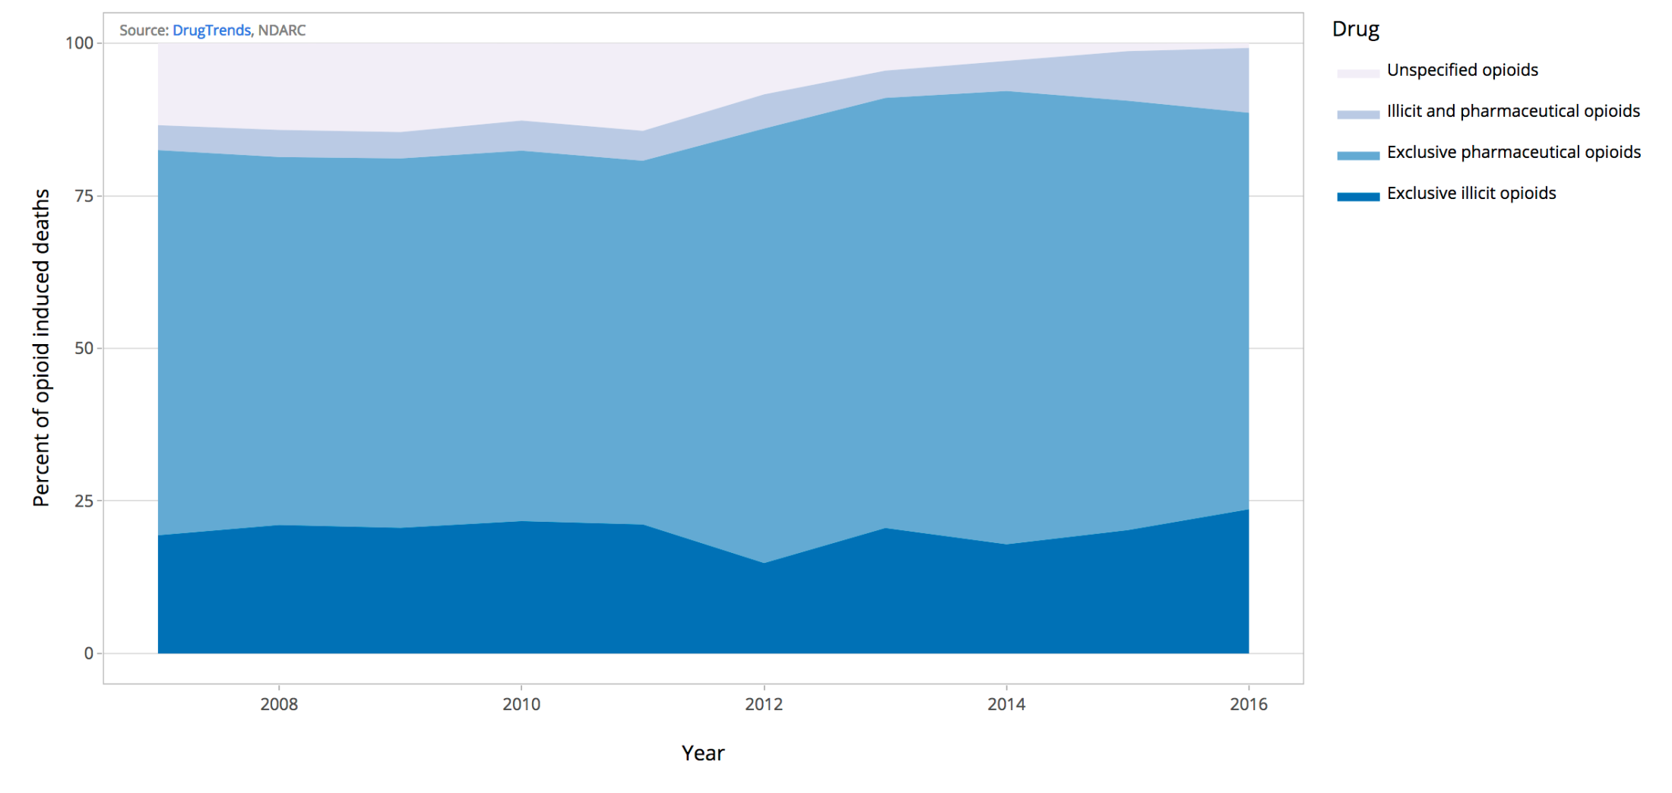
Opioid-induced deaths: exclusive opioids
Illicit opioids include heroin and opium however, the majority of these deaths are attributable to heroin
Pharmaceutical opioids include morphine, methadone, oxycodone, codeine, fentanyl, tramadol and pethidine

Slide 10
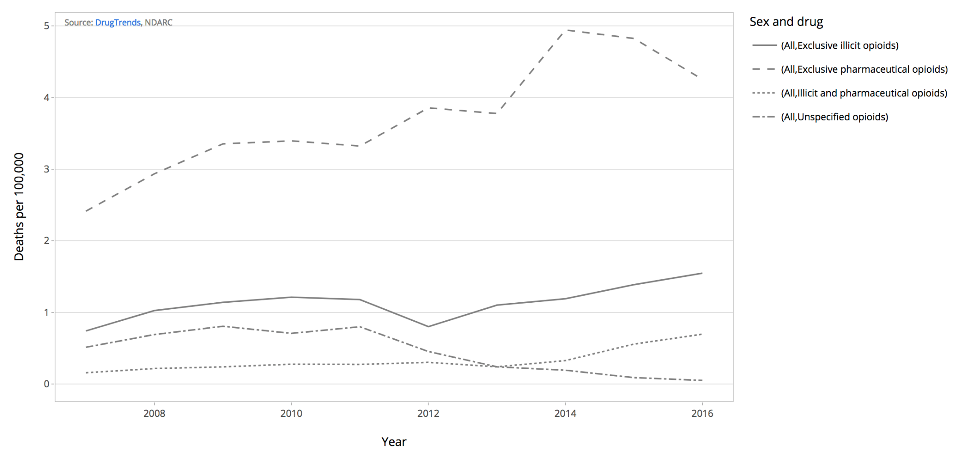
Opioid-induced deaths: exclusive opioids
Exclusive illicit opioids refers to deaths that are attributable exclusively to heroin and/or opium (the majority of these deaths are attributable to heroin)
Exclusive pharmaceutical opioids refers to deaths that are attributable exclusively to opioids including morphine, methadone, oxycodone, codeine, fentanyl, tramadol and pethidine
Illicit and pharmaceutical opioids refers to deaths that are attributable to both illicit and pharmaceutical opioids

Slide 11
Further information
Acknowledgements:
Thanks to Lauren Moran and Shell McConville of the ABS for their assistance with the data provided for this bulletin.
This work was supported by funding from the Australian Government under the Drug and Alcohol Program.
Recommended citation: Roxburgh, A., Dobbins, T., Degenhardt, L. and Peacock, A. (2018). Opioid-, amphetamine-, and cocaine-induced deaths in Australia: August 2018. Sydney: National Drug and Alcohol Research Centre, UNSW
Related Links:
Data visualisations https://drugtrends.shinyapps.io/Deaths
For more information on NDARC research, go to: http://ndarc.med.unsw.edu.au/
For more information about the ABS, go to: http://www.abs.gov.au
For more information on ICD coding go to: http://www.who.int/classifications/icd/en/
For more research from the Drug Trends program go to: https://ndarc.med.unsw.edu.au/program/drug-trends
University of New South Wales, Sydney NSW 2052
Phone: +61 2 9385 0333 Fax: +61 2 9385 0222
Contact us: drugtrends@unsw.edu.au

