Slide 1
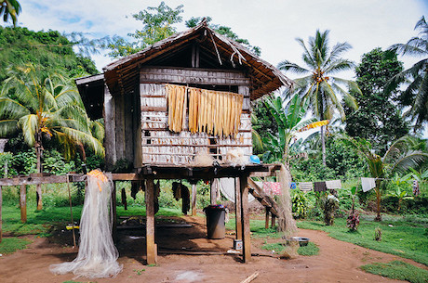
Enhancing outbreak early warning surveillance in low-resourced Pacific island countries
UNSW Medicine Post Graduate Symposium, 2018
Adam Craig, Kirby Institute

Slide 3
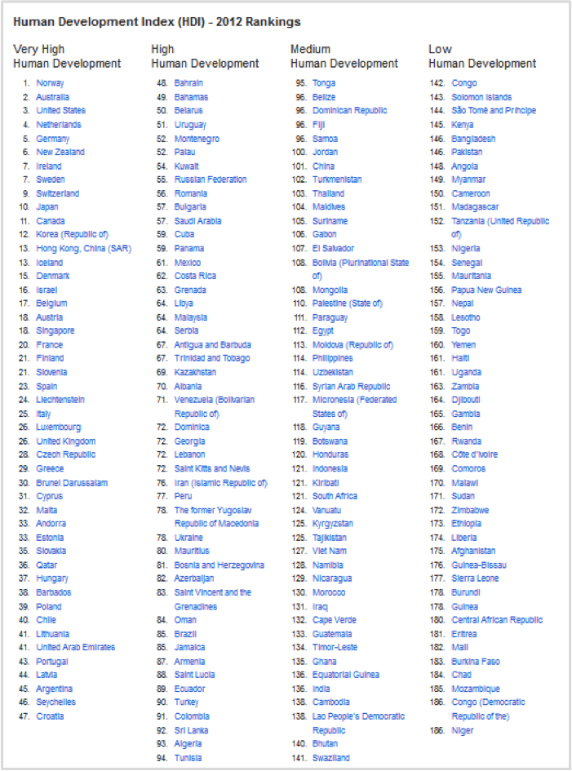
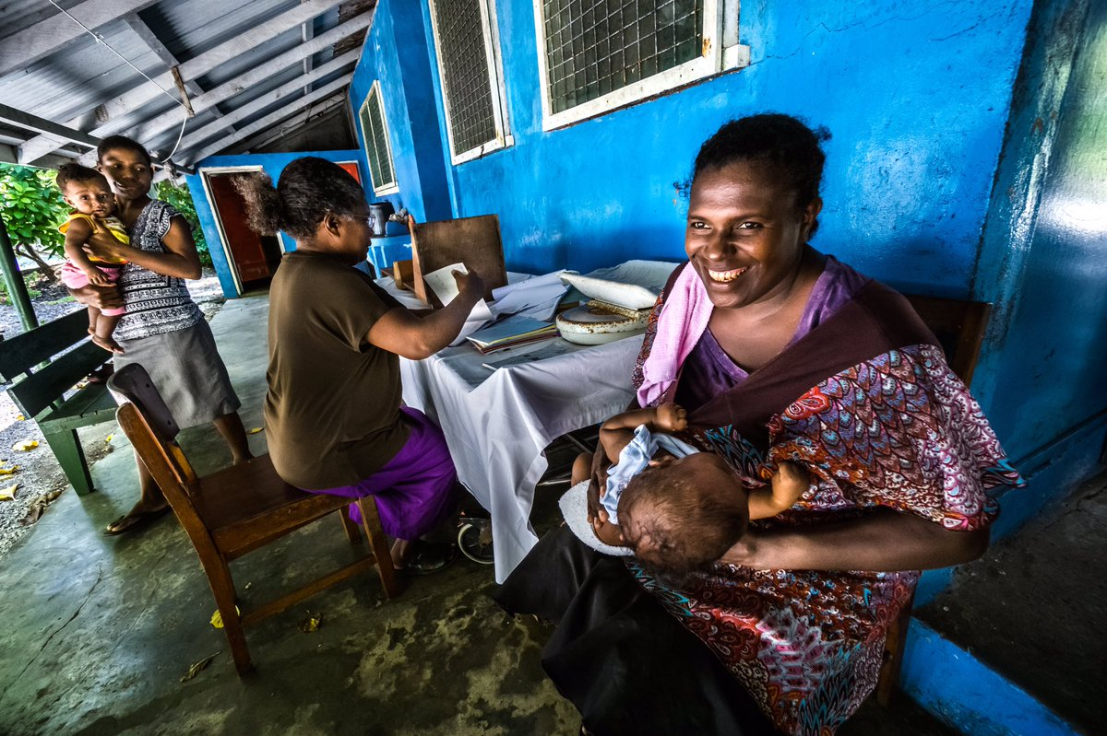

Slide 4
Syndromic surveillance system

Slide 5
AIMS & methods
To determine if the Pacific early warning surveillance system/s are meeting their stated objectives
To produce evidence that will augment key technical elements of the system leading to improved function
Regional
National
Sub-national

Slide 6
High level findings
The PSSS has built an understanding of the value and practice of surveillance, and has provide the infrastructure for early warning surveillance across the Pacific. [Big first steps!]
Simple and flexible enough and meet minimum surveillance requirements during emergencies
The reliance on an algorithm-based detection methods – given the volume and stability of data collected – is inadequate
Inadequate to satisfy new/emerging-disease detection objectives of the IHR(2005). Should be seen as a part of a suite of surveillance strategies.

Slide 7
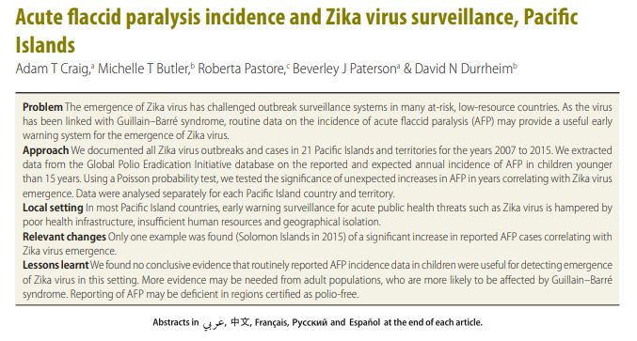
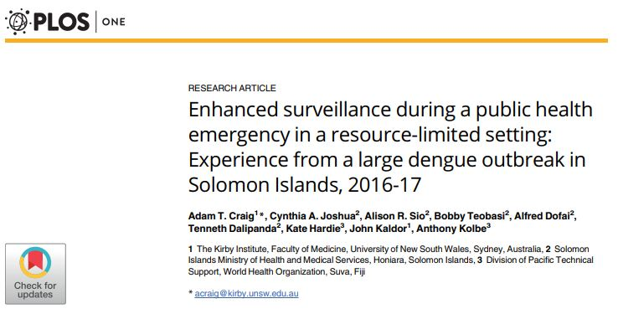
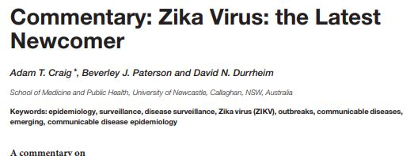
Outputs

Slide 8
Outputs
- Craig, Adam T. et al. (Submitted) Epidemic Surveillance in limited resource settings: lessons from an evaluation of the Solomon Islands early warning surveillance system. BMC Public Health.
- Craig, Adam T et al. (2018) Syndromic surveillance during a public health emergency in a resource constrained setting: Experiences from a large dengue outbreak in Solomon Islands, 2016-17. PLoS ONE.
- Craig, Adam T. et al. (2018) Towards effective outbreak detection: a qualitative study to identify factors affecting nurses’ early warning surveillance practice in Solomon Islands. BMC Health Systems Research.
- Craig, Adam T. et al. (2017): Acute flaccid paralysis incidence and Zika virus surveillance, Pacific Islands. In Bull. World Health Organ. 95 (1), pp. 69–75.
- Craig, Adam T. et al. (2016): Early warning epidemic surveillance in the Pacific island nations: an evaluation of the Pacific Syndromic Surveillance System. In Tropical medicine & International Health.

Slide 9
Contact
e: adam.craig@unsw.edu.au
t: (02) 9385 2241

