Slide 1
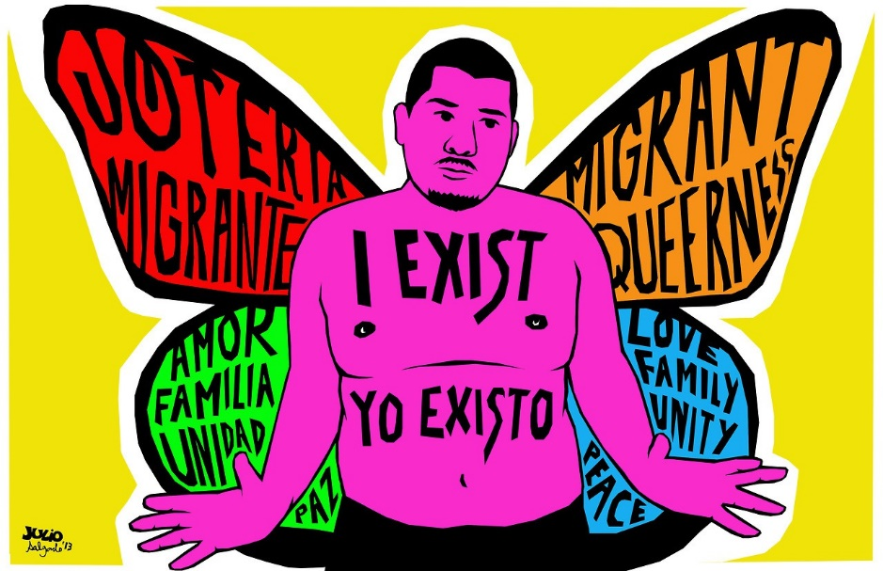
Chinese Queer Migrants in Oz

