Slide 1
Does prison deter drink-drivers?
Sara Rahman and Don Weatherburn

Slide 2
Background
Sanctions for drink driving have become tougher
Average fines have increased
The percentage imprisoned has increased

Slide 3
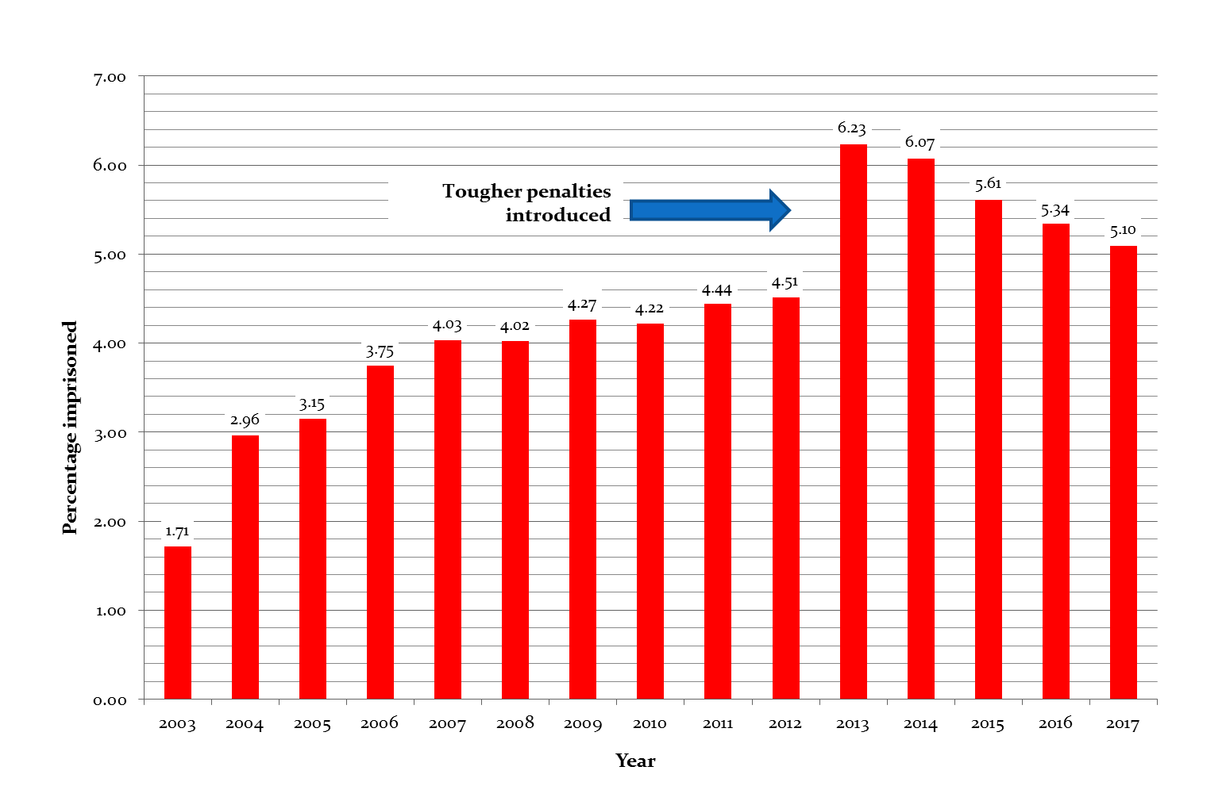

Slide 4
Prison is expensive
Number going to prison each year = 180
Average length of stay = 6 months
Cost per day in prison =$180
Annual cost = approx. $6 million
Growing proportion are Indigenous
But does prison work?

Slide 5
Past research
Nagin, Cullen & Jonson (2009)
“Compared with noncustodial sanctions, incarceration appears to have a null or mildly criminogenic effect on future criminal behaviour”
Villettaz, Gillieron & Killias (2015)
“No significant difference is found in the meta-analysis between four controlled and one natural experiment”
Helland, E. & Tabarrok, A. (2007)
“ California’s three-strike legislation reduces felony arrest rates…by 17-20 per cent”
But no research on prison and drink-driving!

Slide 6

The major challenge
Recidivist offenders more likely to receive a prison sentence
In other words, penalty severity (S) is endogenous
If we estimate:
$$R= α+ β1S+ β2X+ ε$$
Our estimate of $β1$ will be biased and inconsistent
Recidivism (R)
Penalty severity (S)

Slide 7
Solution
Find a factor (instrumental variable) I that influences S but which has no effect on R except through S
Conduct a 2SLS analysis
Stage 1: Regress the likelihood of prison against a vector of controls and the instrument
Stage 2: Include the predicted likelihood of prison obtained in stage 1 among the controls in stage 2
Now by construction the variable measuring penalty severity is purged of its association with factors affecting reoffending

Slide 8
The current study
Examines the effect of prison on drink-drive (DD) recidivism
Includes a large range of controls
Exploits disparity in sentencing as an instrument

Slide 9
Comparison group
Suspended sentence
Must impose a prison sentence before deciding to suspend it
Enhances the likelihood that those who get prison are similar to those who get a suspended sentence

Slide 10
Dependent variables
Whether convicted of another drink-drive offence within 24 months ‘free’ time
Whether convicted of another drink-drive offence within five years ‘free’ time
Whether convicted of any offence within 24 months ‘free’ time

Slide 11
Data
Source:
The NSW Bureau of Crime Statistics and Research re-offending database (“ROD”)
Study samples
7,335 offenders imprisoned for DD
3,946 offenders given a suspended sentence for DD

Slide 12
Analysis
Two stage least squares
$X_{i}=B_{0}+B_{1}Z_{i}+BX+γ+τ$
$Y_{i}=B_{0}+B_{1}{\hat{X}}_{i}+BX+γ+τ$
Where:
$X_{i}$ = probability individual i will be imprisoned
$Y_{i}$ = probability individual i will reoffend
${\hat{X}}_{i}$ = estimated probability individual i will be imprisoned (from equation 1)
Zi = dummy variable where ‘1’ if prison and ‘0’ if suspended sentence
X is a vector of controls
$γ$= court fixed effects
$τ$ = month/year fixed effects

Slide 13
Controls
Age
Gender
Indigenous status
Socioeconomic status
Whether legally represented
No. of concurrent offences
No. prior court appearances
Whether received prior fine
Whether received prior licence disqualification
Whether convicted of a prior traffic offence
Whether convicted of a prior justice procedure offence
PCA range at index contact
Whether previously imprisoned
Whether previously convicted of a violent offence

Slide 14
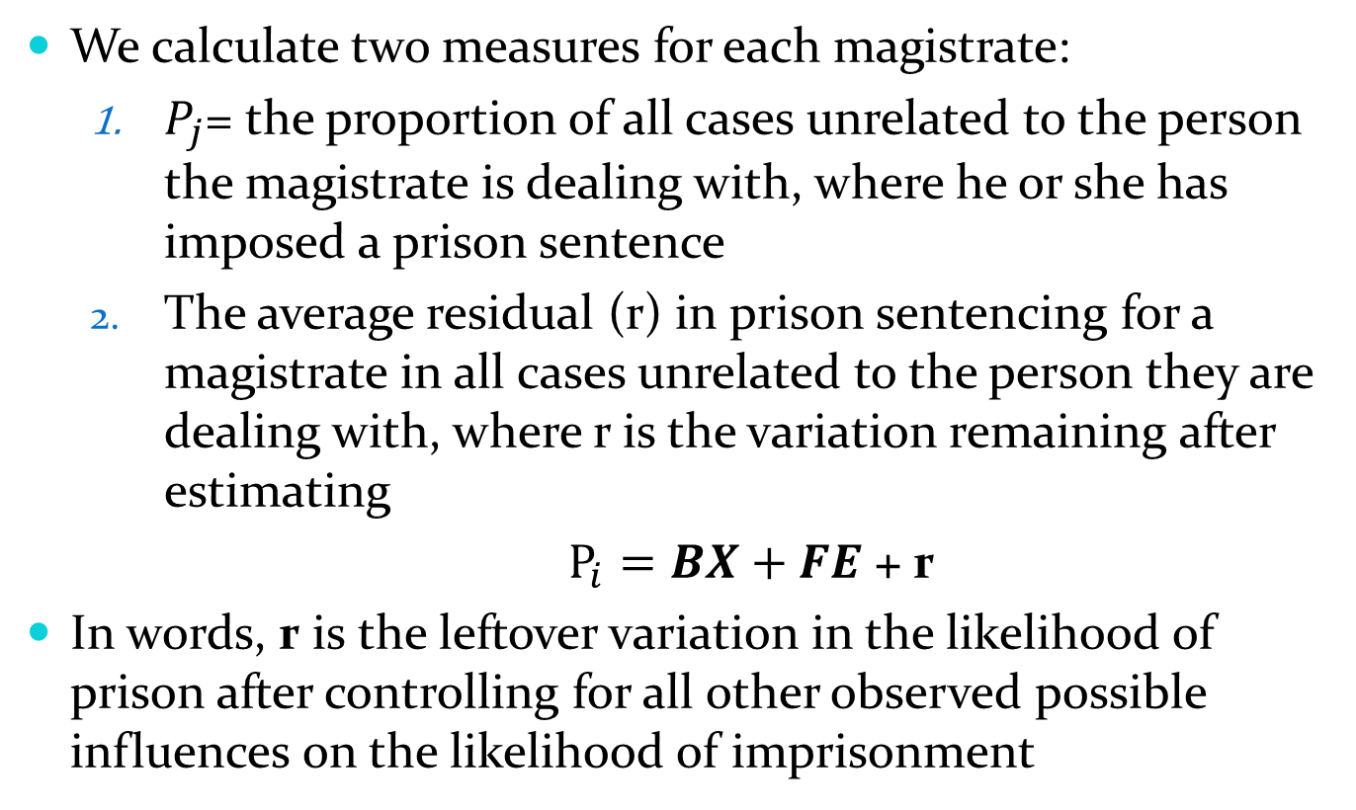
Constructing the instrument
We calculate two measures for each magistrate:
$P_{j}$= the proportion of all cases unrelated to the person the magistrate is dealing with, where he or she has imposed a prison sentence
The average residual (r) in prison sentencing for a magistrate in all cases unrelated to the person they are dealing with, where r is the variation remaining after estimating
$P_{i}=BX+FE$ + r
In words, r is the leftover variation in the likelihood of prison after controlling for all other observed possible influences on the likelihood of imprisonment

Slide 15
Do we have a suitable IV?
Exclusion restriction
Randomness
Relevance
Monotonicity

Slide 16
Exclusion restriction
The IV must not affect the outcome except through its correlation with treatment
Response: Can’t prove this but:
Allocation of cases to magistrates is not based on characteristics of the offender or offence
Magistrates are allocated to courts and must take all cases listed in that court for that day

Slide 17
(Quasi-) randomness
The IV should be quasi-random, i.e. it should not differ based on the unit’s characteristics
Test for randomness:
Regress IV on all observed characteristics and conduct a joint F-test of the explanatory variables
If the variables do not jointly determine IV then the IV can be considered quasi-random
F-statistic _{(unresidualised)} = 1.07 (p = 0.37)
F-statistic _{(residualised)} = 1.32 (p = 0.14)

Slide 18
Relevance
The IV must strongly affect the likelihood of treatment
The common test is that the partial F-test of the first stage equation should exceed ten (10)

Slide 19
Relevance
Sample 1: Prison vs. suspended sentences | Partial F-statistic
Outcome: PCA offence in 24 months free time
2SLS (Unresidualised) | 271.22
2SLS (Residualised) | 188.50
Outcome: PCA offence in 5 years free time
2SLS (Unresidualised) | 271.22
2SLS (Residualised) | 188.50
Outcome: Any re-offence in 24 months free time
2SLS (Unresidualised) | 269.03
2SLS (Residualised) | 185.97

Slide 20
Monotonicity
The IV must significantly affect treatment in the same direction for all subgroups or not be significantly different from zero
34/40 groups have a positive and significant effect (remainder non-significant)

Slide 21
Variable | Variable value | Suspended sentence | Prison
Age group | 17-22 | 400 (5.5%) | 165 (4.2%)
 | 23-29 | 1229 (16.8%) | 576 (14.6%)
 | 30-34 | 997 (13.6%) | 590 (15.0%)
 | 35+ | 4708 (64.2%) | 2614 (66.3%)
Sex/Gender | Female | 1100 (15.0%) | 235 (6.0%)
 | Male | 6235 (85.0%) | 3711 (94.0%)
Indigenous Status | Indigenous | 521 (11.0%) | 563 (19.8%)
 | Non-Indigenous | 4198 (89.0%) | 2285 (80.2%)
Area | Major cities | 3711 (53.6%) | 1616 (47.1%)
 | Inner regional, outer regional and remote | 3211 (46.4%) | 1818 (52.9%)
Socio-economic disadvantage of postcode | Highly advantaged | 976 (14.1%) | 319 (9.3%)
 | Advantaged | 1716 (24.8%) | 799 (23.3%)
 | Disadvantaged | 2231 (32.3%) | 1076 (31.4%)
 | Highly disadvantaged | 1994 (28.8%) | 1236 (36.0%)
Legal representation | No | 856 (12.1%) | 322 (8.5%)
 | Yes | 6197 (87.9%) | 3445 (91.5%)
Number of concurrent offences | 1 | 4176 (56.9%) | 1223 (31.0%)
 | 2 | 1866 (25.4%) | 1317 (33.4%)
 | 3+ | 1293 (17.6%) | 1406 (35.6%)
Number of prior court appearances | 0 | 1042 (14.2%) | 261 (6.6%)
 | 1 | 1452 (19.8%) | 431 (10.9%)
 | 2 | 1362 (18.6%) | 523 (13.3%)
 | 3 | 945 (12.9%) | 462 (11.7%)
 | 4+ | 2534 (34.5%) | 2269 (57.5%)

Slide 22
Variable | Variable value | Suspended sentence | Prison
Prior penalties - fine | No | 3652 (49.8%) | 1425 (36.1%)
 | Yes | 3683 (50.2%) | 2521 (63.9%)
Prior penalties - licence disqualification | No | 3847 (52.4%) | 1427 (36.2%)
 | Yes | 3488 (47.6%) | 2519 (63.8%)
Prior offences - traffic | No | 3658 (49.9%) | 1314 (33.3%)
 | Yes | 3677 (50.1%) | 2632 (66.7%)
Prior offences - driving | No | 6487 (88.4%) | 2695 (68.3%)
 | Yes | 848 (11.6%) | 1251 (31.7%)
Prior offences - justice procedures | No | 6208 (84.6%) | 2784 (70.6%)
 | Yes | 1127 (15.4%) | 1162 (29.4%)
PCA range at index | High | 5072 (69.1%) | 2673 (67.7%)
 | Medium | 2263 (30.9%) | 1273 (32.3%)
Prior penalties - imprisonment | No | 6355 (86.6%) | 2373 (60.1%)
 | Yes | 980 (13.4%) | 1573 (39.9%)
Prior offences - violence | No | 6082 (82.9%) | 2835 (71.8%)
 | Yes | 1253 (17.1%) | 1111 (28.2%)

Slide 23
Results
Prison vs. suspended sentences |  | Coeff. (prison) | p-value
Outcome: PCA offence in 24 months free time
OLS |  | 0.01 | .263
2SLS (Unresidualised) |  | -0.01 | .636
2SLS (Residualised) |  | -0.01 | .601
Outcome: PCA offence in 5 years free time
OLS |  | 0.02 | .113
2SLS (Unresidualised) |  | -0.01 | .636
2SLS (Residualised) |  | -0.01 | .601
Outcome: Any re-offence in 24 months free time
OLS |  | -0.01 | .255
2SLS (Unresidualised) |  | -0.12 | .021
2SLS (Residualised) |  | -0.13 | 0.026

Slide 24
Conclusion
Not much evidence that prison is a specific deterrent to drink-driving
But some evidence of a specific deterrent effect???
DD result not surprising
Low risk of apprehension/given offending
Low risk of imprisonment/given apprehension
Most offenders quit after their first conviction
Better off blocking the opportunities for drink-driving
E.G. Ignition interlocks

Slide 25
The end

