Slide 1
Adverse adult consequences of different alcohol use patterns in adolescence E Silins, LJ Horwood, JM Najman, GC Patton, JW Toumbourou, CA Olsson, DM Hutchinson, L Degenhardt, D Fergusson, D Becker, JM Boden, R Borschmann, M Plotnikova, GJ Youssef, RJ Tait, P Clare, WD Hall & RP Mattick

Slide 2
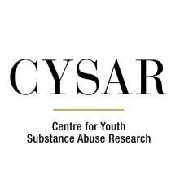
Acknowledgements
The Cannabis Cohorts Research Consortium
NHMRC Project Grant (no. 1064893)

Slide 3
Overview
Background
Methods
Results
Conclusions

Slide 4
Background
About 18% of Australian teenagers have used alcohol.¹
There is a growing trend of teenagers abstaining from alcohol:
2013 - 72% abstained; 2016 - 82% abstained
And younger people are delaying drinking:
Average age of initiation was 14.7 years in 2001; 15.7 in 2013; 16.1 in 2016

Slide 5
Background
Despite this, young adults aged 18-24 years were the group most likely to be heavy binge drinkers (11+ drinks per session):
In 2016 15% of young adults had binged at that level at least monthly.

Slide 6
Background
This research was conducted to get a better understanding of the impact of teenage drinking.
This research aimed to estimate the strength of association between different patterns of adolescent drinking and later psychosocial harms.

Slide 7
Methods
The study was made up of over 9,000 adolescents who were followed from age 13 to age 30.
Participants were drawn from:
The Australian Temperament Project²
The Christchurch Health and Development Study³
The Mater Hospital and University of Queensland Study of Pregnancy⁴
The Victorian Adolescent Health Cohort Study⁵

Slide 8
Methods
Our exposures were different patterns of drinking before age 17:
Frequent drinking (never, <weekly, weekly+)
Number of drinks consumed per session (<=2, 3-4, 5-6, 7+)
Problem drinking (assessed by number of alcohol related problems, e.g., problems at school, legal problems) (0, 1-2,, 3-4, 5+)

Slide 9
Methods
Our outcomes included a range of different psychosocial outcomes in adulthood, including:
Drinking related outcomes
Tobacco, cannabis, and other illicit drug use
Sexual risk-taking and early parenthood
High school and university completion
Mental health problems
Quality of partner relationships

Slide 10
Results

Slide 11
Results

Slide 12
Results

Slide 13
Results

Slide 14
Results
Adult outcome | Exposure to alcohol prior to age 17 years
 | Max. frequency of alcohol use % |  | Max. no. of standard drinks consumed per drinking occasion % |  | Max. no. of alcohol-related problems %
 | a | b | a | b | a | b
Weekly or more frequent alcohol use at age 21 | 19.7 | 4.9 | 5.6 | 1.2 | 6.6 | 0.5
Weekly or more frequent binge drinking at age 21 | 22.3 | 6.8 | 8.9 | 2.1 | 10.4 | 1.1
Number of alcohol-related problems at age 21 | 34.8 | 10.6 | 16.4 | 4.7 | 29.4 | 3.8
Drink-driving at age 21 | 21.2 | 3.1 | ns | ns | ns | ns
Alcohol dependence by age 24 | ns | ns | ns | ns | 20.7 | 2.7
Alcohol dependence by age 30 | 31.0 | 5.4 | ns | ns | -^{c} | -^{c}
Current tobacco use at age 21 | 10.9 | 2.9 | ns | ns | ns | ns
Recent other illicit drug use at age 21 | ns | ns | 9.8 | 2.4 | ns | ns
Antisocial behaviour at age 21 | ns | ns | ns | ns | 10.5 | 0.6

Slide 15
Conclusions
There is evidence of a strong and direct relationship between drinking in teens and problem drinking in adulthood;
How often you drink in adolescence predicts drinking problems in adulthood just as much as (and possibly more than) the amount you drink; and,
Discouraging or delaying alcohol use in adolescence is likely to have substantial benefits in terms of preventing harmful drinking in adulthood.

Slide 16
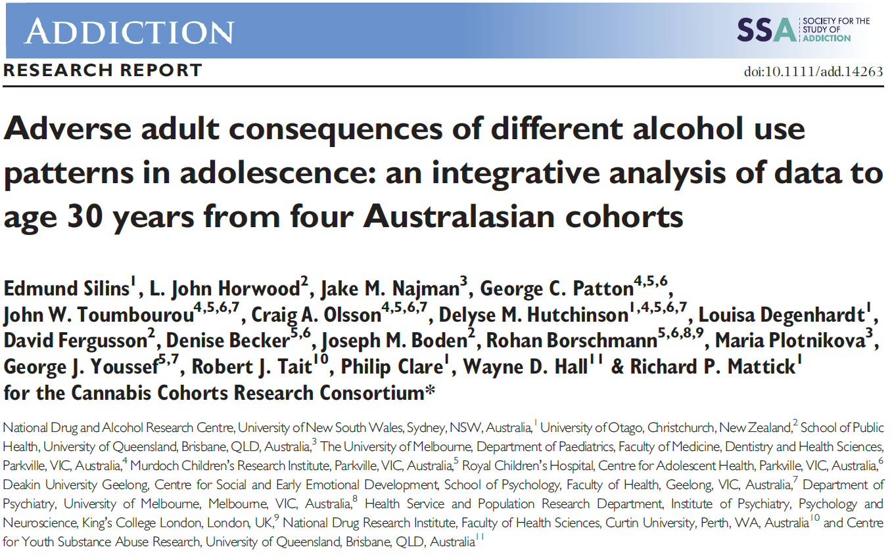
Article

Slide 17
References
1. Australian Institute of Health and Welfare 2017. National Drug Strategy Household Survey 2016: detailed findings. Drug Statistics series no. 31. Cat. no. PHE 214. Canberra: AIHW.
2. Vassallo S., Sanson A. The Australian Temperament Project: The first 30 years. Melbourne: Australian Institute of Family Studies; 2013.
3. Fergusson D., Horwood J. The Christchurch Health and Development Study: review of findings on child and adolescent mental health. Aust NZ J Psychiatry 2001; 35:287–96.
4. Najman J., Alati R., Bor W., Clavarino A., Mamun A., McGrath J. et al. Cohort profile update: the Mater-University of Queensland Study of Pregnancy (MUSP). Int J Epidemiol 2015; 44: 7878–NaN–78f.
5. Patton G., Coffey C., Lynsky M., Reid S., Hemphill S., Carlin J., et al. Trajectories of adolescent alcohol and cannabis use into young adulthood. Addiction 2007; 102: 607–15.

