Slide 1
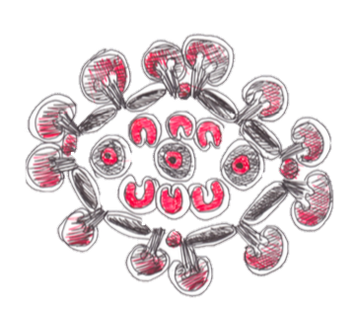
Youth Research Network (YARRN)
Improving social, economic and health outcomes for high-risk young people in remote communities: the adaptation and implementation of a transdisciplinary research approach.
Skye Bullen

Slide 2
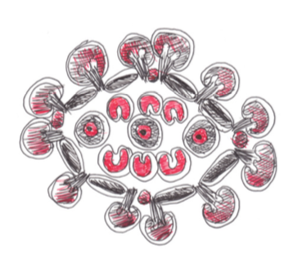
Background
Young people exposed to multiple, co-occurring risk factors experience disproportionately high rates of harm, and Indigenous adolescents are over-represented in this population
These harms persist over their lifetimes, negatively impacting on their ability to participate meaningfully in society
A high proportion of these young people are at very high risk of ending up in juvenile detention, after which their outcomes are much worse
The overall aim of our research is to build evidence for community-based services that minimise the number of young people who get sent to juvenile detention

Slide 3
Plan for this new research
To answer a number of sequential questions (the grey text is research by Alice Knight* and my research is the black text)
Can we develop an evidence-based model of care for community-based programs working with high-risk young people?
Can we establish a suite of relevant, acceptable measures and embed them into routine service delivery?
Can we pilot test this model to establish an initial baseline estimate of how effective it is likely to be, what it costs to deliver, and whether it is a good value for money (economic evaluation)?
Can we then generalise the measures and the model of care to similar services nationally, and evaluate its impact across multiple community-based programs?
*NB: Anthony Shakeshaft supervised Alice Knight’s research with the BackTrack program and was CIA. He is the brother of the Manager and Founder of BackTrack (Bernie Shakeshaft). Supervisor Myf Maple previously provided voluntary and informal research advice to BackTrack.

Slide 4
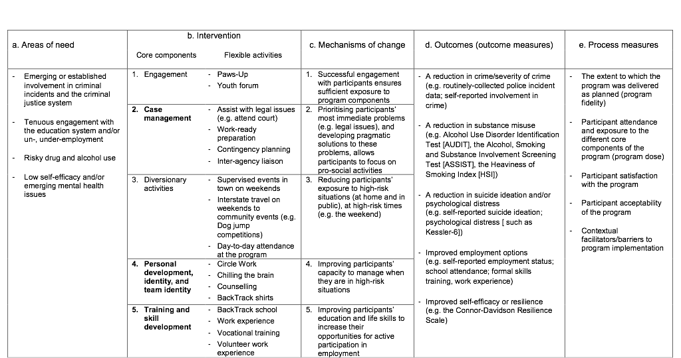
An evidence-based model of care
This is the initial model developed. The bolded core components came from Alice Knight’s systematic review, the others from the staff of one service
It also shows some of the measures (columns d and e)

Slide 5
Pilot test – does it seem to work?
Benefits for participants and the community (yet to be confirmed):
Significant reduction in suicide ideation. Almost significant reduction in monthly cannabis use
Significant reduction in crime incidents for 15-18 year old males in 2 out of 3 communities
Good value for money (likely to be about $3 in savings from less harm for every $1 invested)
Now the questions are*:
Can we embed the model of care and the measures into community-based programs nationally?
Can we demonstrate comparable outcomes across multiple services in multiple communities?
*NB: this new project is funded by an ARC Discovery grant
Notes:
Research studies have repeatedly shown that psycho-social harms cluster around high-risk individuals, high-risk families and high-risk neighbourhoods. These harms include suicide, domestic violence, crime, injuries and accidents, and premature death. These harms are not just to individuals, but spill-over into negative impacts on families and communities through a range of harms, including the experience of violence, being victims of crime and feeling unsafe.
The causal factors associated with being at high-risk of harm, and experiencing these harms, are mental health, drug and alcohol abuse and being of low-SES. Therefore, being more proactive in addressing these issues, as opposed to predominantly being reactive, is one promising way to reduce a whole range of harms across communities generally, but especially reducing harms that are clustered around high-risk families and neighbourhoods within communities.
Program returns about $3.50 in cost savings (reduced crime, increased employment, etc) for every $1 invested

Slide 6
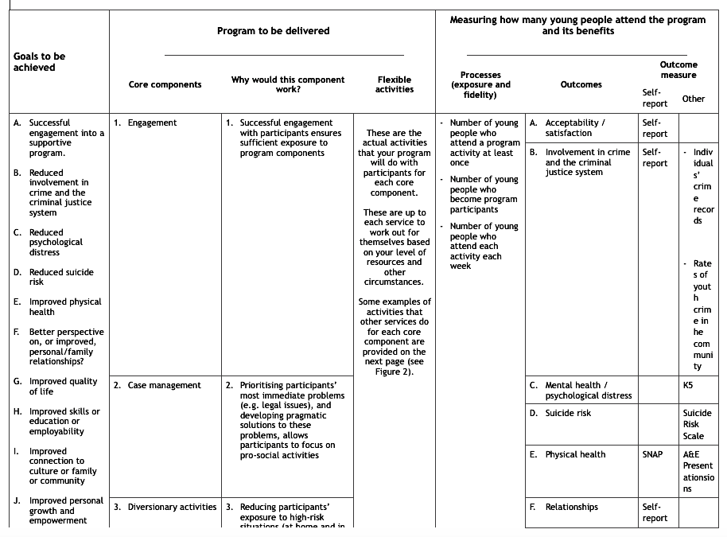
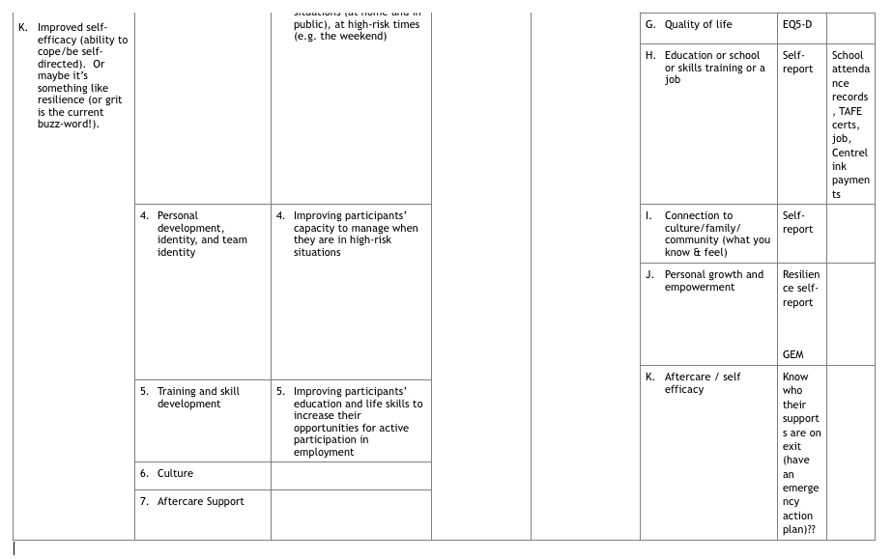
New model of care
This is the new model that has been tested and amended by staff from services who are participating in the research

Slide 7
Indigenous Data Sovereignty (IDS)
At present in Australia, Aboriginal people have low control over Indigenous data. We need to progress from the current point to a point where we have high control over our own data.
The overall aim is to shift the ownership, control, access and possession (OCAP) of data about Aboriginal people in Australia to Aboriginal people.
To do that, we need to understand how OCAP would work in practice – what are the principles that should govern how OCAP would work in Australia? How they can be operationalised in practice?
My research is looking at the published academic literature to see what sort of principles for OCAP have been proposed in Australia and other countries. The project has embedded current principles intro research practice
Reviewing & classifying 78 studies from search. <10 papers that explicitly talk to OCAP principles.

