Slide 1
Untreated Remission from Alcohol Problems: A Mixed Methods Approach
Richard Mellor¹
Supervisors: Professor Alison Ritter³, Dr Kari Lancaster²
¹ Drug Policy Modelling Program, National Drug and Alcohol Research Centre, University of New South Wales, Sydney; ² Centre for Social Research in Health, University of New South Wales, Sydney; ³ Drug Policy Modelling Program, Social Policy Research Centre, University of New South Wales, Sydney

Slide 2
My PhD……in a single slide
Project 1: estimates of untreated remission from alcohol problems within the context of treatment planning (systematic review and treatment modelling analysis).
Project 2: estimate untreated remission in Australia (online survey;
n = 816).
Project 3: compare people who remit without treatment to people who remit with treatment (online survey; n = 816).
Project 4: qualitative (life narratives; n =12).
Contexts: improving clinical practice; representing a diversity of recovery narratives; closing the treatment gap; accelerating natural recovery.

Slide 3
Systematic Review: Treatment Planning
Treatment Planners need to know how many people with alcohol problems need treatment.
This involves estimating the numbers of people who remit without treatment.
Estimates of untreated remission from alcohol problems are wide ranging.
Systematic review:
Examine the ways estimates of untreated remission from alcohol problems are impacted by different methods and definitions.
Understand the implications for treatment planning.

Slide 4
Systematic Review: Results
124 estimates (across 27 studies): ranged from 2.7% to 98.3%.
Methods to Estimation:
Method 1: people with alcohol problems; proportion that remit without treatment (mean = 22%).
Method 2: untreated people with alcohol problems; proportion that remit (mean = 41%).
Method 3: people in remission; proportion that have not received treatment (mean = 43%).
Definitional Variability:
Alcohol Problem: more lenient definitions - higher estimates (method 2 and 3).
Remission: more lenient definitions - higher estimates (all methods).
Treatment: more inclusive definitions - lower estimates (method 1 and 3).

Slide 5
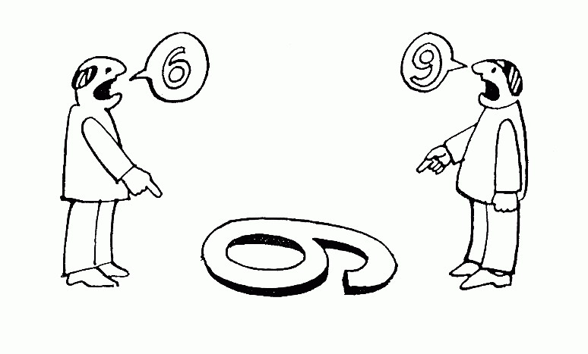
Systematic Review: Implications for Treatment Planning
Treatment resources are limited (do not want to overestimate demand).
Take people who remit without treatment out of the planning equation.
Which estimates treatment planners use will depend upon the goals of the treatment plan.

