Slide 1
Are indexes a useful measure for drug policy research?
Vivienne Moxham-Hall
Supervisors: Professor Alison Ritter and Dr Caitlin Hughes
2018 Postgraduate Research Symposium

Slide 2
What is an index?
Multidimensional indicator
Combines several different aspects of a complex issue to create a single summable score
“Combining apples and oranges in order to compare them”
Thesis investigates indexes via
the creation of two distinct indexes
Cannabis laws and regulations
Opioid overdose prevention laws

Slide 3
Index Construction Example: The Australian Cannabis Laws and Regulations Index (ACLRI)
Index of Cannabis Laws and Regulations in Australia
Prison sentence | Years
Fine | Dollars
Threshold quantity | Grams
License suspension | Months
Common metric
Consumer offences
Diversion schemes
Cultivation offences
Weighting
Supply offences
Drug Driving offences

Slide 4
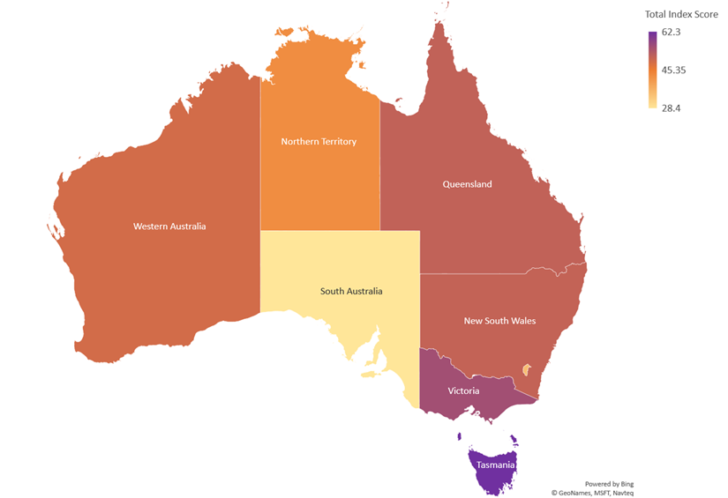
Index scores (2016) by state or territory

Slide 5
What can an index of drug laws tell us?
Pros Enables high-level analysis of law platforms across time and place Simple and easy to interpret | Cons Too abstract to identify the roles of specific laws – is one or all the laws driving the result?

Slide 6
Thank you
Vivienne Moxham-Hall
Email: v.moxham-hall@unsw.edu.au
Twitter: @vividity

