Slide 1
Balancing the risks and the benefits of using HIV self-testing among gay and bisexual men
Ye Zhang| November 2018
Supervisory team: Prof. Rebecca Guy
Dr. Tanya Applegate
A/Prof Virginia Wiseman

Slide 2
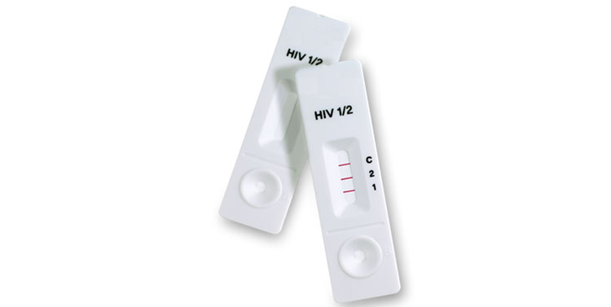
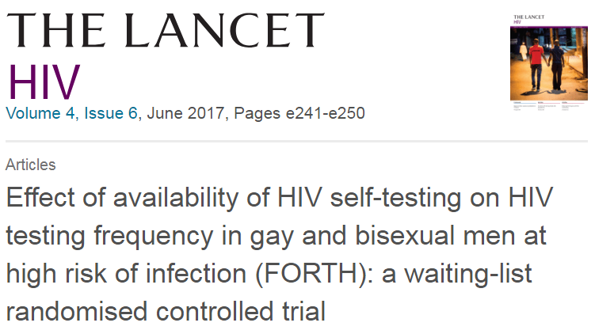
Background
Globally around 1/3 of all people living with HIV remain undiagnosed
HIV self testing (HIVST)
Notes:
Currently, globally around one-third of people living with HIV have not been diagnosed. One strategy that may help increase HIV testing is self-testing, which someone who wants to know his or her HIV status can test and interpret the test result themselves in private. Forth study as the first random trial of HIVST in the world has showed that HIVST could significant increase the uptake and frequency of HIV testing.

Slide 3
Background
Globally around 1/3 of all people living with HIV remain undiagnosed
HIV self testing (HIVST)
Remain Concerns
Intimate Partner violence
Poor follow up
Psychological distress
Suicide
Notes:
However, the remaining concerns of unsupervised HIVST still in the field, the people afraid that without on time consulting, user who got HIV positive result will meet severe psychological distress, intimate partner violence, or even suicide. These concerns make it is extremely important to hear from people about their experience of using HIVST.

Slide 4
Primary Aim
This study aims to evaluate the perceptions and experience of using HIVST among gay and bisexual men.
The study has conducted 16 in-depth interviews among gay and bisexual men
Notes:
This study is the first qualitative study of FORTH study.
We conducted 16 qualitative interviews. We used a thematic analysis methodology to analyse these qualitative data.

Slide 5
Key Themes
EASY & PRIVATE
“ I like it cause it’s private, it’s, it’s easy. Like cook an egg.”
CONTROL
“So I’m sort of quite comfortable with the idea of being my own doctor and making decisions about myself, informed decisions about what maybe I, I need, in consultation with my doctor. And a home test can do that.”
Notes:
Men found many benefits of using HIVST, participants reported HIVST is private and easy to use, also afford their the logistical and psychological control.

Slide 6
INCREASING TESTING FREQUENCY
“You can go in and choose when you want to be tested as opposed to, which means that you may test more often”
ALTRUISM
“If I'm completely honest, I didn't do this for my own benefit. I actually did it more as a giving back kind of thing.”
Notes:
Furthermore, Self-testing could increase their testing frequency and help generate community excitement and a sense of altruism about HIV prevention.

Slide 7
WINDOW PERIOD
“it’s that window period I suppose. So that, that’s probably the drawback I see with it is that fact that there is some degree of uncertainty”
NO STIs
“The test is only for HIV; it’s not for any other STDs and things like that. So, if you were sexually very active, yes, you may know what your HIV status is but you don’t know what else you’ve got”
Notes:
At the same time, participants were aware of the test`s window period, the time when the tests would fail to identify an infection and they viewed it as the only drawback of the test, some of them also complain about HIVST lack of other STI test, which mean they still need to go the clinic for full sexual health check.

Slide 8
Conclusion
Men weighed the pros and cons of HIVST
Men would liked to using HIVST in the future as an enhancement for conventional testing
There is still a question about the sustain the frequent testing facilitated by HIVST
Capitalism on enthusiasm and other support may be required.
Notes:
Men weighed the pros and cons of HIVST in our study. Men’s awareness of these limits allowed them to excuse inaccuracies – including false negatives result–and take responsibility for using the test in a way that ignored the window period. The men would like to using self testing in the future, describing it as an enhancement for conventional testing. However, while self testing encouraged more frequent testing, many were also not sure that they would sustain the frequent testing facilitated by self testing. , these findings suggest that efforts to sustain that impact – including capitalise on enthusiasm and other support – may be required.

